Slide 1
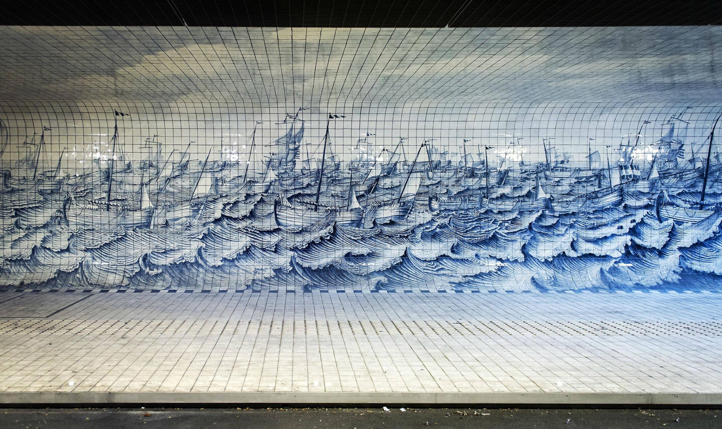
jUNCuyperspassage, Amsterdam June 19, 2018 15:00
Singing the Tunnel Red
(the Empire Back?)
a performing intervention

Slide 2
The Cuyperspassage (named after Pierre Cuyper, the architect of the Rijksmuseum and Central Station)
Text description provided by the architects. "Cuyperspassage is the name of the new tunnel at Amsterdam Central Station that connects the city and the waters of the IJ-river. Since the end of 2015 it has been used by large numbers of cyclists, some 15,000 daily, and pedestrians 24 hours a day. This ‘slow traffic corridor’ was exactly what many users of the city felt was lacking. What once was by necessity a left or right turn is now, at long last, straight ahead. The tunnel is clad on one side by nearly 80,000 Delft Blue tiles: a true Dutch spectacle at a central spot in Amsterdam.
The tunnel is 110 metres long, ten metres wide and three metres high. Its design makes a clear division between the two modes of travel. By making the pedestrian level appreciably higher than the cycleway, pedestrians know where they have to be and feel safe there. Cyclists enjoy the spatial sensation of a rapid through route, accompanied by a continuous run of LED lamps along the raised edge of the footpath. The pedestrian path has a smooth finish of handmade glazed ceramic tiles. The cycleway by contrast has a rougher, open finish of black sound-absorbing asphalt and steel gratings. This is to enhance user comfort, given the tunnel’s concrete structure and great length. The gratings are impossible to litter with posters and flyers and their open structure reduces the risk of graffiti.
https://www.archdaily.com/780990/cuyperspassage-benthem-crouwel-architects

Slide 3
A Urban Room: a kitchen ... a bathroom
"Along the footpath wall is a tile tableau designed by Irma Boom Office. The design steps off from a restored work by the Rotterdam tile painter Cornelis Boumeester (1652-1733). His tile panel depicting the Warship Rotterdam and the Herring Fleet is in the collection of the Rijksmuseum, Amsterdam. Irma Boom replaced the original crest on the stern with the Amsterdam coat of arms. The cyclist or pedestrian leaves the old historic part of Amsterdam through Cuyperspassage and heads towards ‘new Amsterdam’ in the north, or vice versa. The tableau fades away towards the IJ-river, the lines of the original work gradually dissolving. Then it builds up again in an abstract form from light to dark blue, as if encouraging cyclists to slow down as the ferry comes into view. Its drawn lines and pixels also visualize the transition in art from the old to the new. The ceramic company, Royal Tichelaar Makkum, spent five years making the 46,000 wall tiles for the tableau, as well as 33,000 floor tiles, in the traditional Dutch tile size of 13 x 13 cm. In it, we see large and small merchant vessels, herring busses with nets in place, churning waves, gulls. The whole recalls old kitchens in Amsterdam canal houses, so that the tunnel is experienced as a safe place – as an urban room."
https://www.archdaily.com/780990/cuyperspassage-benthem-crouwel-architects

Slide 4
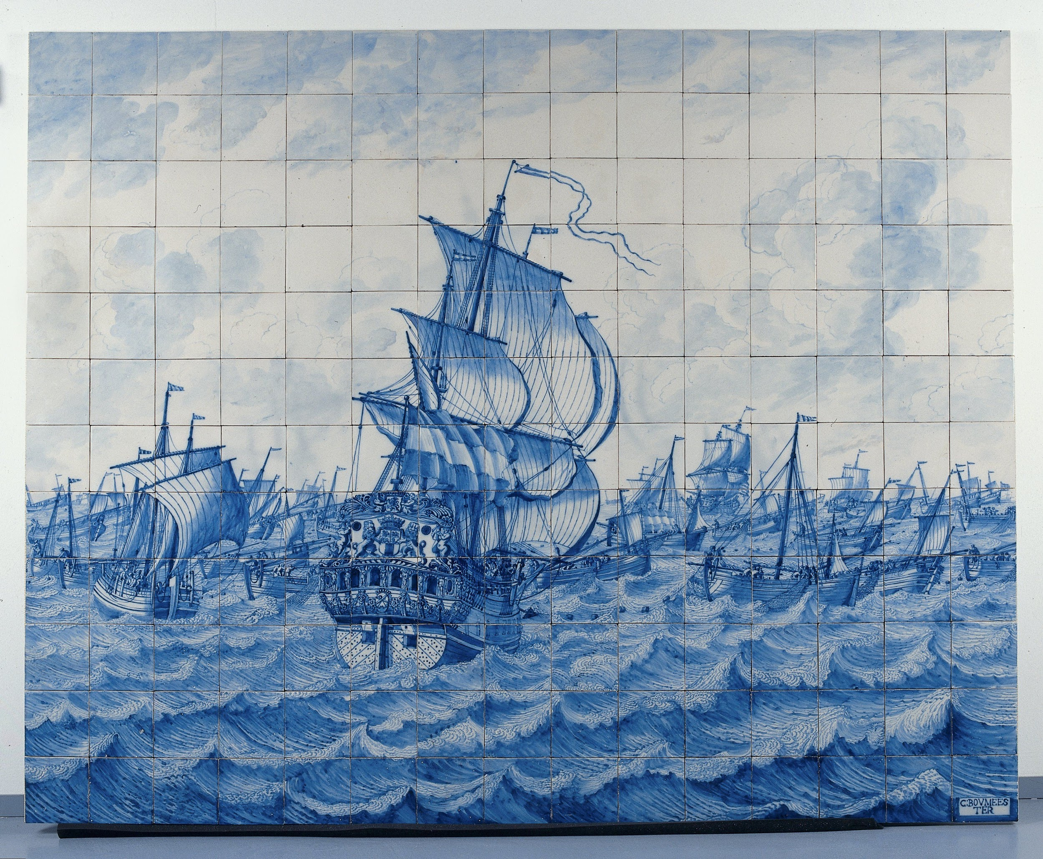
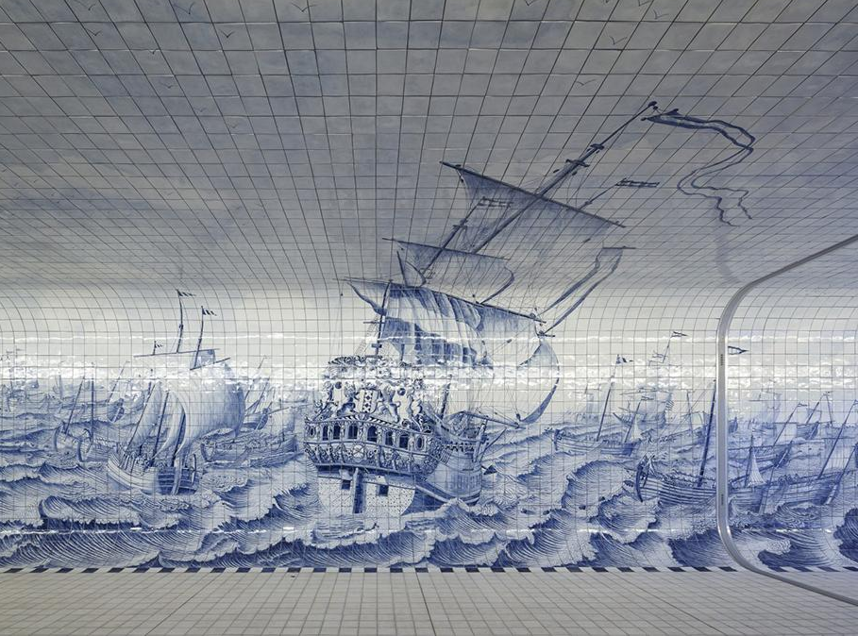
Tile Panel depicting the Warship Rotterdam and the Herring Fleet, Cornelis Boumeester, c. 1700 - c. 1725, Rijksmuseum
Cuyperspassage, Irma Boom Office, 2011

Slide 5
The Warship...and the harring fleet
The Dutch East India Company had a total of six shipyards: Amsterdam, Hoorn, Enkhuizen, Delft, Rotterdam and Middelburg. But the largest and most important by far was Amsterdam. Some half of the tonnage of all East India Company ships built between 1602 and 1799 came together here.
(https://www.hetscheepvaartmuseum.com/collection/articles/695/east-india-company-shipyard-amsterdam)

Slide 6
Points of departure
What is there? Visible and invisible
Exploring different ways of relating with the cultural objects produced by the city for watching/ passing by/ photograph
Exposing - Performing the invisible/ Sounding the flag (or/and what else?)

Slide 7
INSPIRATIONAL THEORY
"NATIONAL IDENTITY ..IS EMBEDDED IN ROUTINES OF LIFE, 'FLAGGINGS' ARE SO NUMEROUS AND FAMILIAR THAT THEY OPERATE MINDLESSLY ..THE REMEMBERING, NOT BEING EXPERIENCED AS REMEMBERING, IS, IN EFFECT, FORGOTTEN" .."IT CEASES TO APPEAR AS NATIONALISM, DISAPPEARING INTO THE '’NATURAL' ENVIRONMENT OF '’SOCIETIES'’ (Billig, 38)
Michael Billig "Banal Nationalism" → Invisible flaggings
Michel De Certeau "Walking in the city" → Pedestrian Tactics of Resistance
W.J.T. Mitchell "What do pictures really want?" → From smashing to sounding
Gloria Wekker "White Innocence" → Questioning the Dutch sense of self
Judith Butler "Bodies in Alliance and the Politics of the Street → Bodies claiming the public space

Slide 8
A critical practice in which one strikes images "with just enough force to make them resonate, but not as much as to smash them"
"I think it may be time to rein in our notions of the political stakes
in a critique of visual culture and to scale down the rhetoric of the "power of
images." Images are certainly not powerless, but they may be a lot weaker than we
think. The problem is to refine and complicate our estimate of their power and
the way it works. That is why I shift the question from what pictures do to what they
want, from power to desire, from the model of the dominant power to be
opposed, to the model of the subaltern to be interrogated or (better) to be invited
to speak. If the power of images is like the power of the weak, that may be why
their desire is correspondingly strong, to make up for their actual impotence. We
as critics may want pictures to be stronger than they actually are in order to give
ourselves a sense of power in opposing, exposing, or praising them. "(Mitchell,74)
"Nietzsche tells us that he will "philosophize with a hammer," striking not at temporary idols, but at the "eternal idols" that have mystified the entire philosophical tradition. What is sometimes forgotten is that he goes on to elaborate the metaphor of the hammer, depicting it not as an instrument for destruction, but for "sounding the idols." In case we miss the point, he even goes on to elaborate it further by trading in the figure of the hammer for that of the "tuning fork" as the instrument for striking the idols. "
(http://www.visual-studies.com/interviews/mitchell.html)

Slide 9
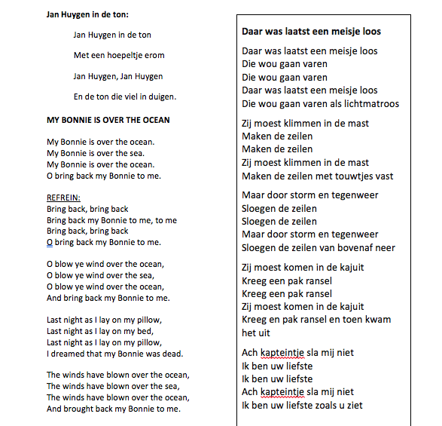
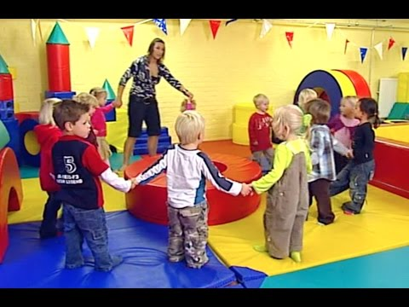
An innocent performance
Children / folk sailors songs

Slide 10
