Slide 1
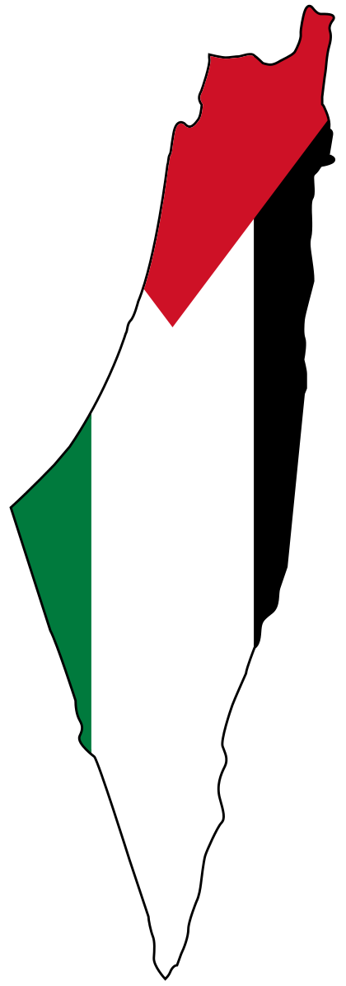
Public Intervention
by Amina & Luca

Slide 2
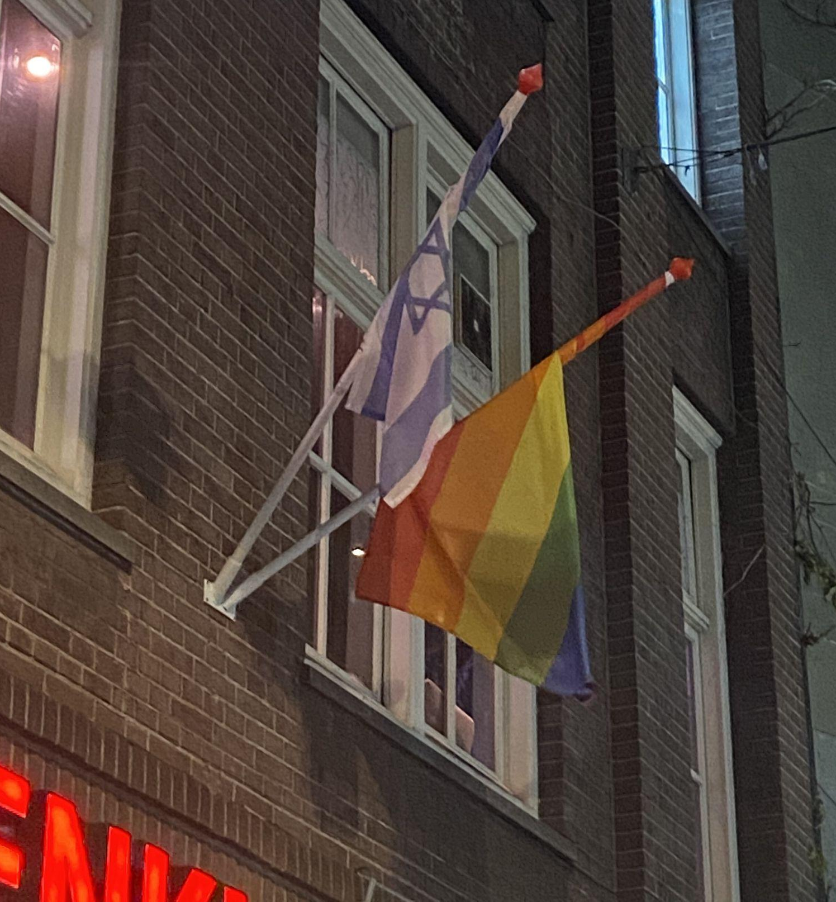
Flags that we spotted
On the left is pictured the Israeli flag, and on the right we can see the pride flag:
Location in the city of Amsterdam:

Slide 3
Our thoughts about it
Israel detains, interrogates & imprisons children, prosecutes them in juvenile military courts. We wanted to bring to light the hypocrisy of a government that claims to care about lgbtq+ rights whilst also clearly committing multiple crimes against humanity.
We can interpret this as an attempt on Israel’s part to uphold western ideologies that would allow them to stay allied to their biggest sponsor: the United States of America (which provide them with $3.8 billion in military aid every year).

Slide 4
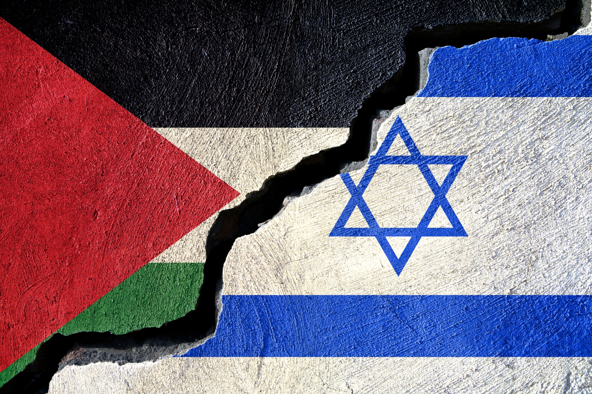
Short recap of Israeli-Palestine conflict
https://youtu.be/iRYZjOuUnlU

Slide 5
Our biggest question is
How can you claim to care about people’s lives when you are the first and biggest oppressor in your region?
According to statistics, about 50% of Europeans believe that being critical of the Israeli government is proof of anti-semitic rhetoric. However, Jewish people and Israeli people are two separate groups
It is noteworthy that ever since the war in Ukraine began on February 24th all Russian flags have been taken down throughout Europe, yet Israeli ones are still up. It is a western interest to oppose Russia and to support Israel.
We find that hypocritical since both situations are about ethnic cleansing. But one is towards newly European citizens (which is also ironic since Ukraine’s claim to join the EU had been denied multiple times before the war), and the other is towards Arab people.

Slide 6
Our contribution
We went around that street to take photos. And as we were doing that, we were approached by multiple groups of people from different backgrounds to have discussions about the topic.
People who actively engaged in the conversation and seemed more knowledgeable about the topic were mostly arab, whereas other nationalities either preferred no to give their opinion on the subject or were completely misinformed.
So we decided to distribute sticker-flags of Palestine around Amsterdam since they are never seen anywhere (unless it’s next to the Israeli one).

Slide 7
