Slide 1
Operation Mistletoe

Slide 2
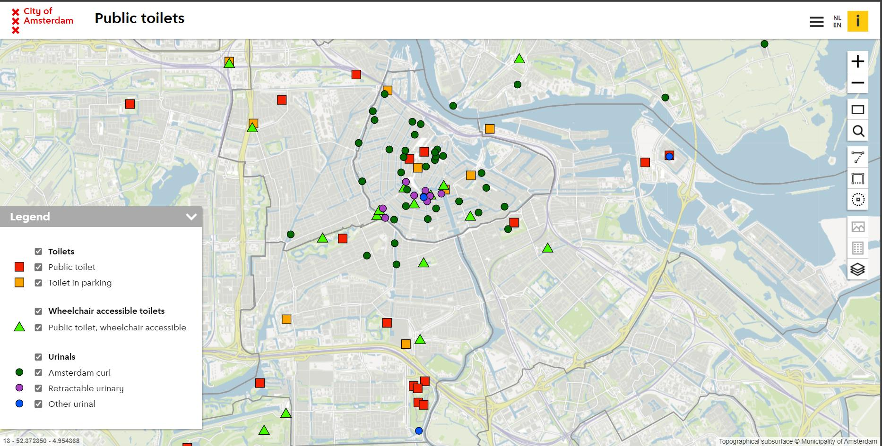
Topic one
Topic two
Topic three
Topic four
Topic five

Slide 3
News that a Dutch woman was fined €90 (A$133) after being caught urinating in an alleyway in central Amsterdam has sparked an online debate about sexism.
Geerte Piening, 23, found herself caught short without a public toilet after a night out drinking with friends in Amsterdam in 2015, the BBC reports.
There are only three public toilets designed for women in Amsterdam, compared to 35 public urinals for men. With the bars and restaurants now closed, and the nearest public toilet a couple of kilometres away, Piening decided to relieve herself in a side street.
She was caught by three police officers, who issued her with the fine.
At the time I really didn't want to get involved in a discussion. But the next day I thought, just a minute, I'm going to fight this," she said.
The male judge told her she should have used one of the men's urinals rather than urinating in public - an offence which is known as 'wildplassen' in Dutch.
The hashtag #wildplassen has taken off on social media, with many people expressing support for Piening and herstance.

Slide 4
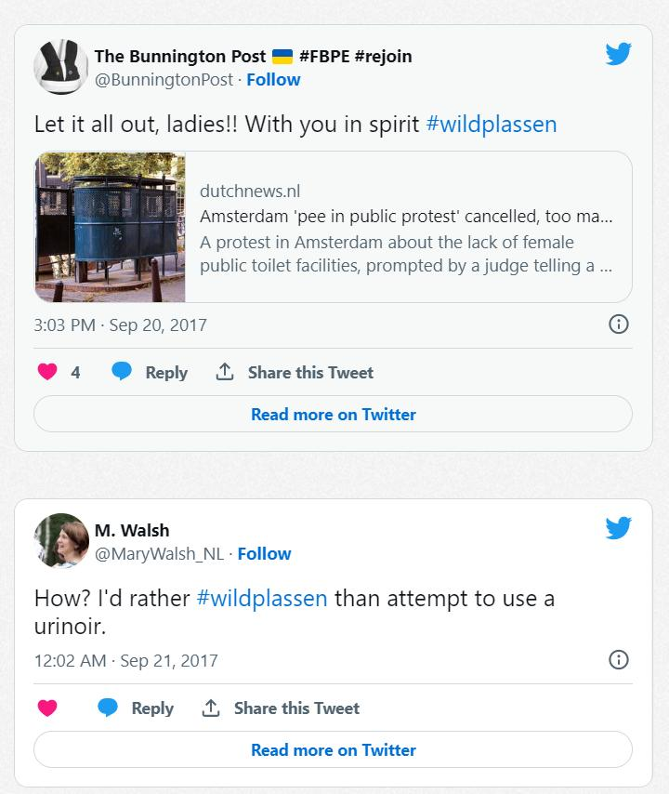

Slide 5
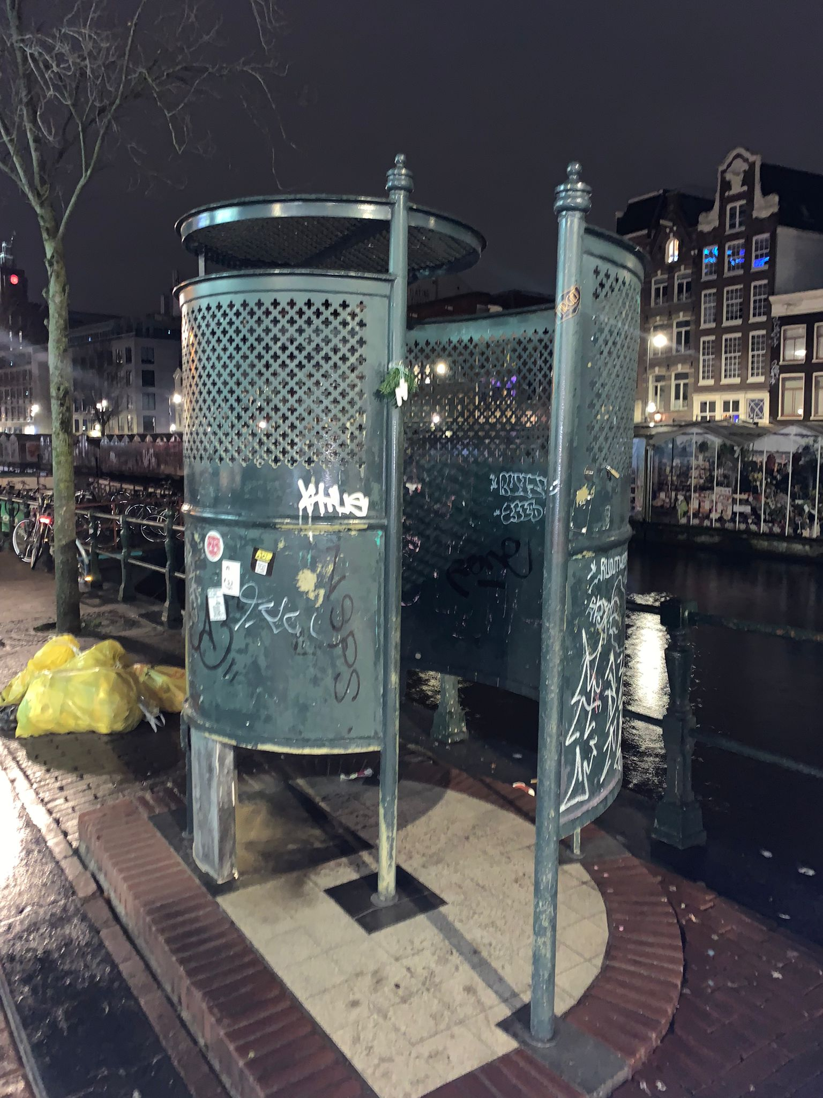
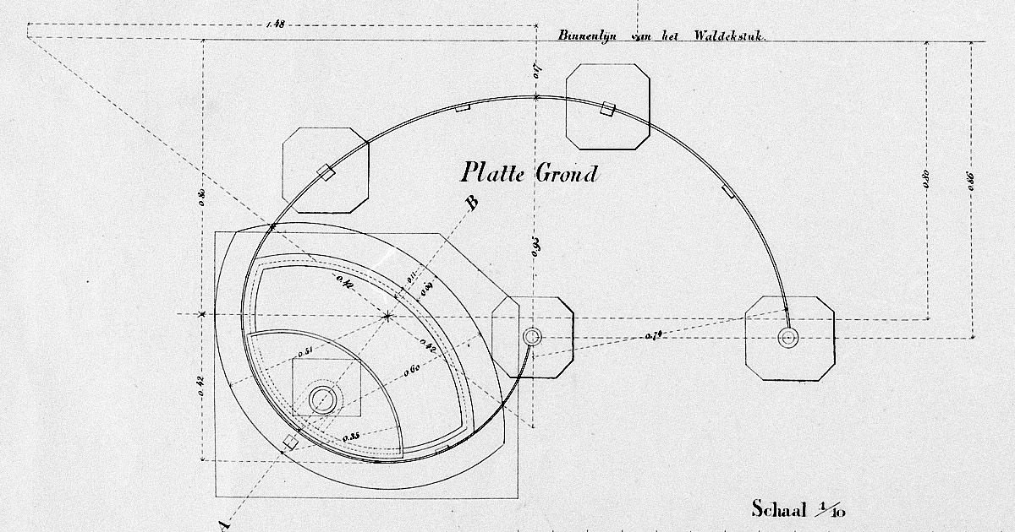
The Amsterdam Curl

Slide 6
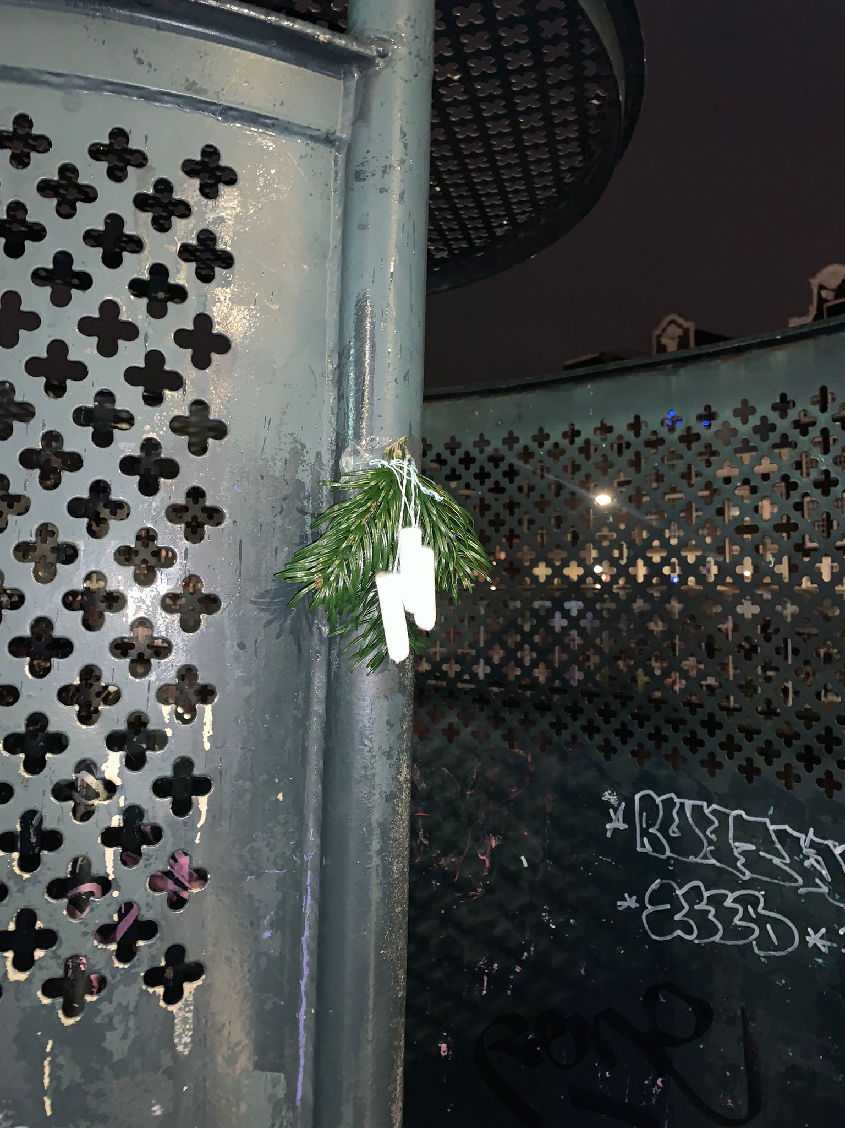
Mistletoe Tampons

Slide 7
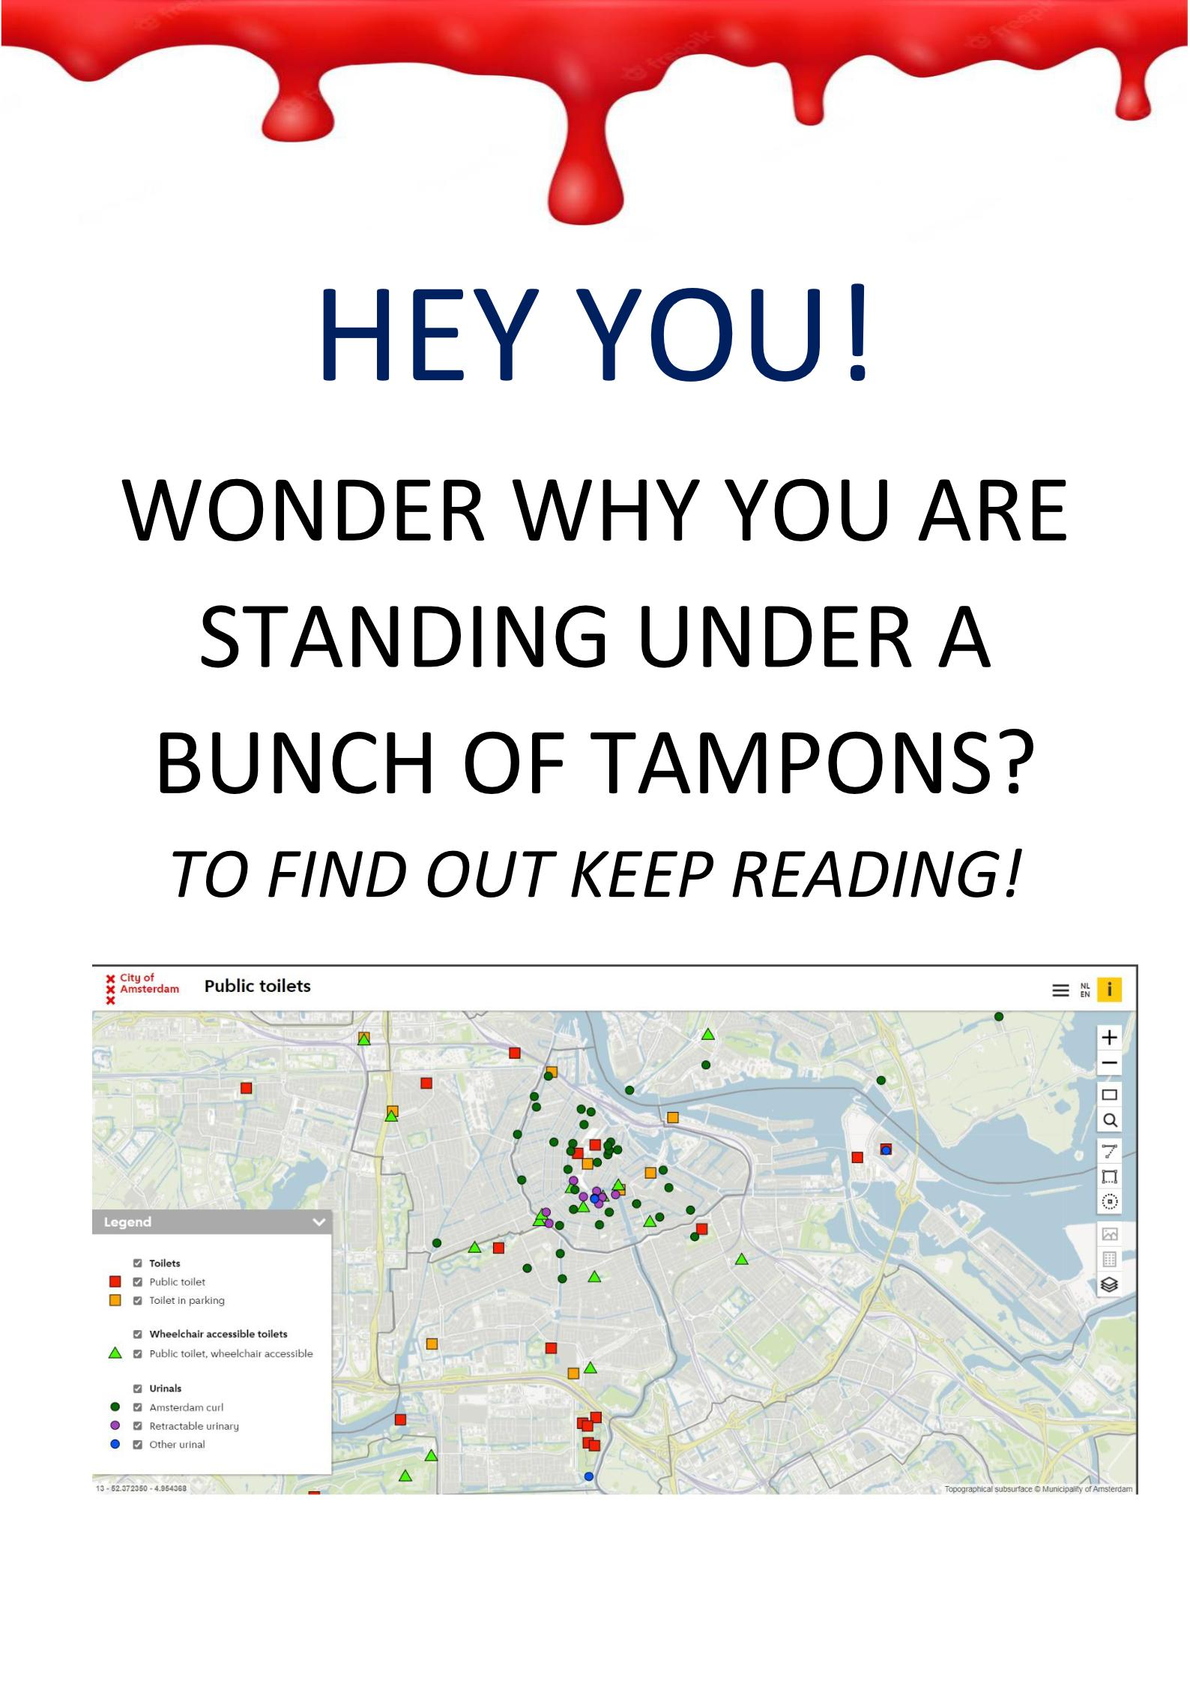

Slide 9
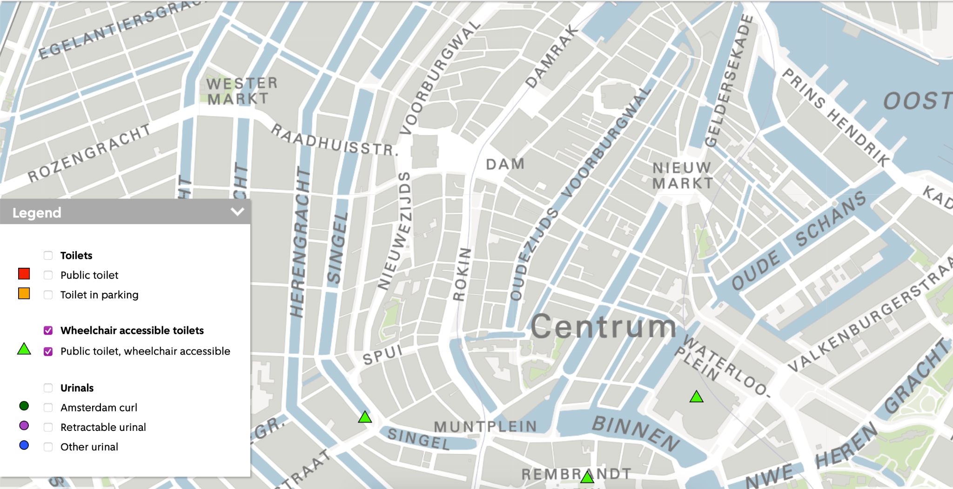
A bathroom and a tampon is needed for both of them.
In the centre of Amsterdam around the Dam, a woman who is not in a wheelchair can use one of two available public bathrooms the Geemente Amsterdam provides.
Two you think? That is not enough?
Right but a women in a wheelchair can access the bathroom in Cafe Schuim if she asks kindly or sneaks in quietly or a toilet of one of her friends if she gives them a call.
A woman in a wheelchair is more or less dependent on the public bathrooms provided which are…none

Slide 10
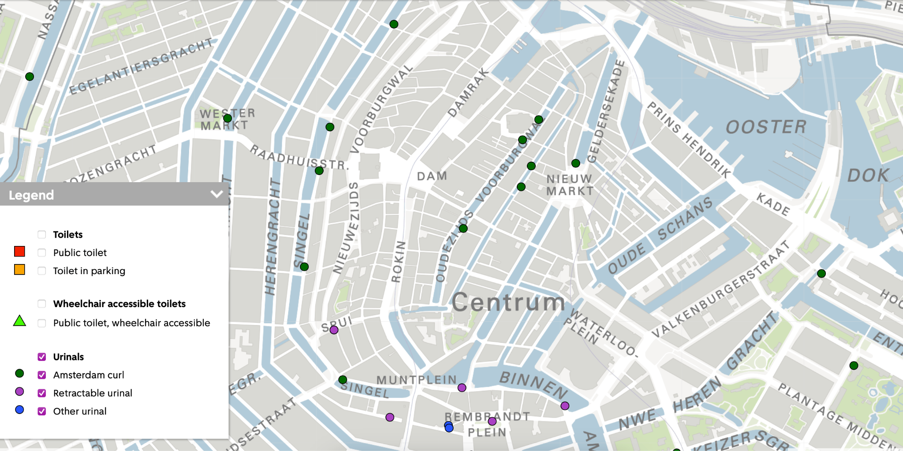
How are we going to solve this problem, you ask?
In Amsterdam we have 35 urinals. Urinals which allow only men to pee in public whenever there is need to. We have Amsterdam curl or Retractable urinals, or the other urinals as the city of Amsterdam likes to label them on their map of public toilets.
What if we replace a couple of those Amsterdam curl urinals or Retractable urinals
or the other urinals with public toilets that are accessible for women in wheelchairs?
We have enough intersectional issues.
Let’s not make menstruating one of them.

