Slide 1
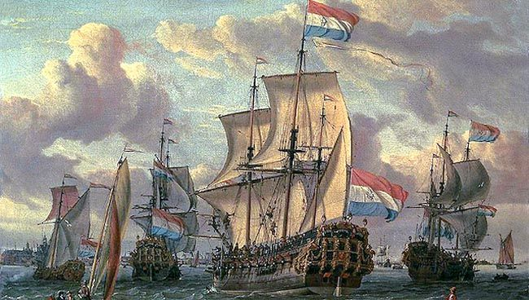
Public Intervention
Colonialism
By Esther, Lois, Leila and Pina

Slide 2
“At the same time, the geo-political, cultural and racial heterogeneity of postcolonial discourses itself provokes a questioning of the apparently stable, established values of canonicity, with its assumptions of paternity and inheritance, its homogenizing linearity of influence, and its cultural exclusivity” (Bennett and Royle, 223)

Slide 3
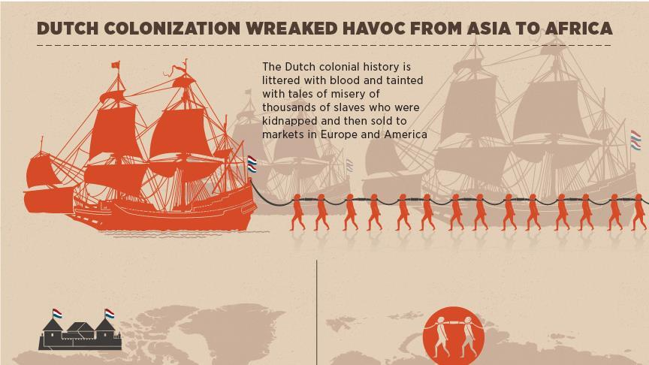

Slide 4
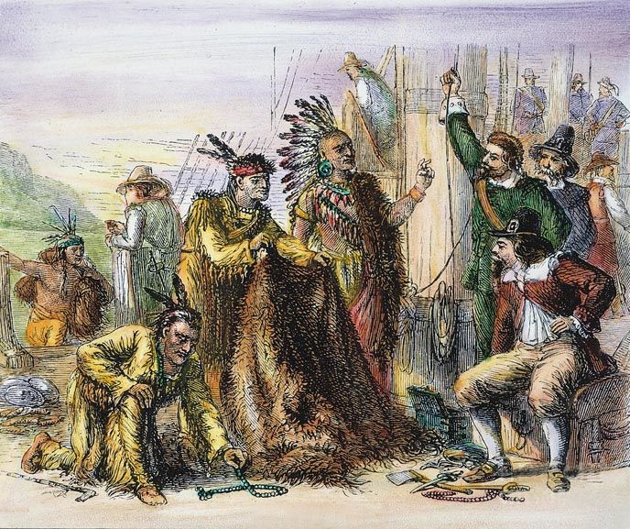
“Western humanism necessarily defines itself through terms of race, by constructing a racial other which then stands in opposition to the humanity of the racially homogeneous” (Bennett and Royle, 223)

Slide 6
Bushuis/Oost-Indisch Huis, Kloveniersburgwal 48. - Now Humanities Faculty of Uva

Slide 8
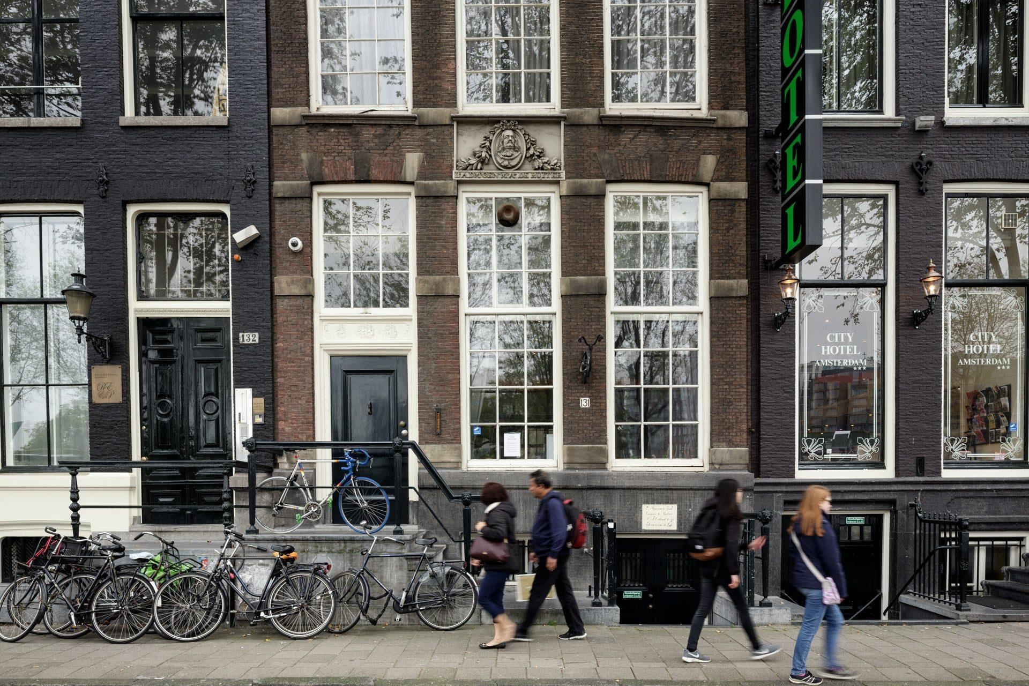

Slide 10
Racism is, before anything else, the delusion of essentialism (Bennett and Royle, 223)
As Robert Young points out, the invention of modern concepts of ‘human nature, together with ideas about the universal nature of humanity and the human mind, occurred during the centuries characterized in the West by colonization, ‘those particularly violent centuries in the history of the world now known as the era of Western colonization’ (Young 1990, 121)

Slide 11
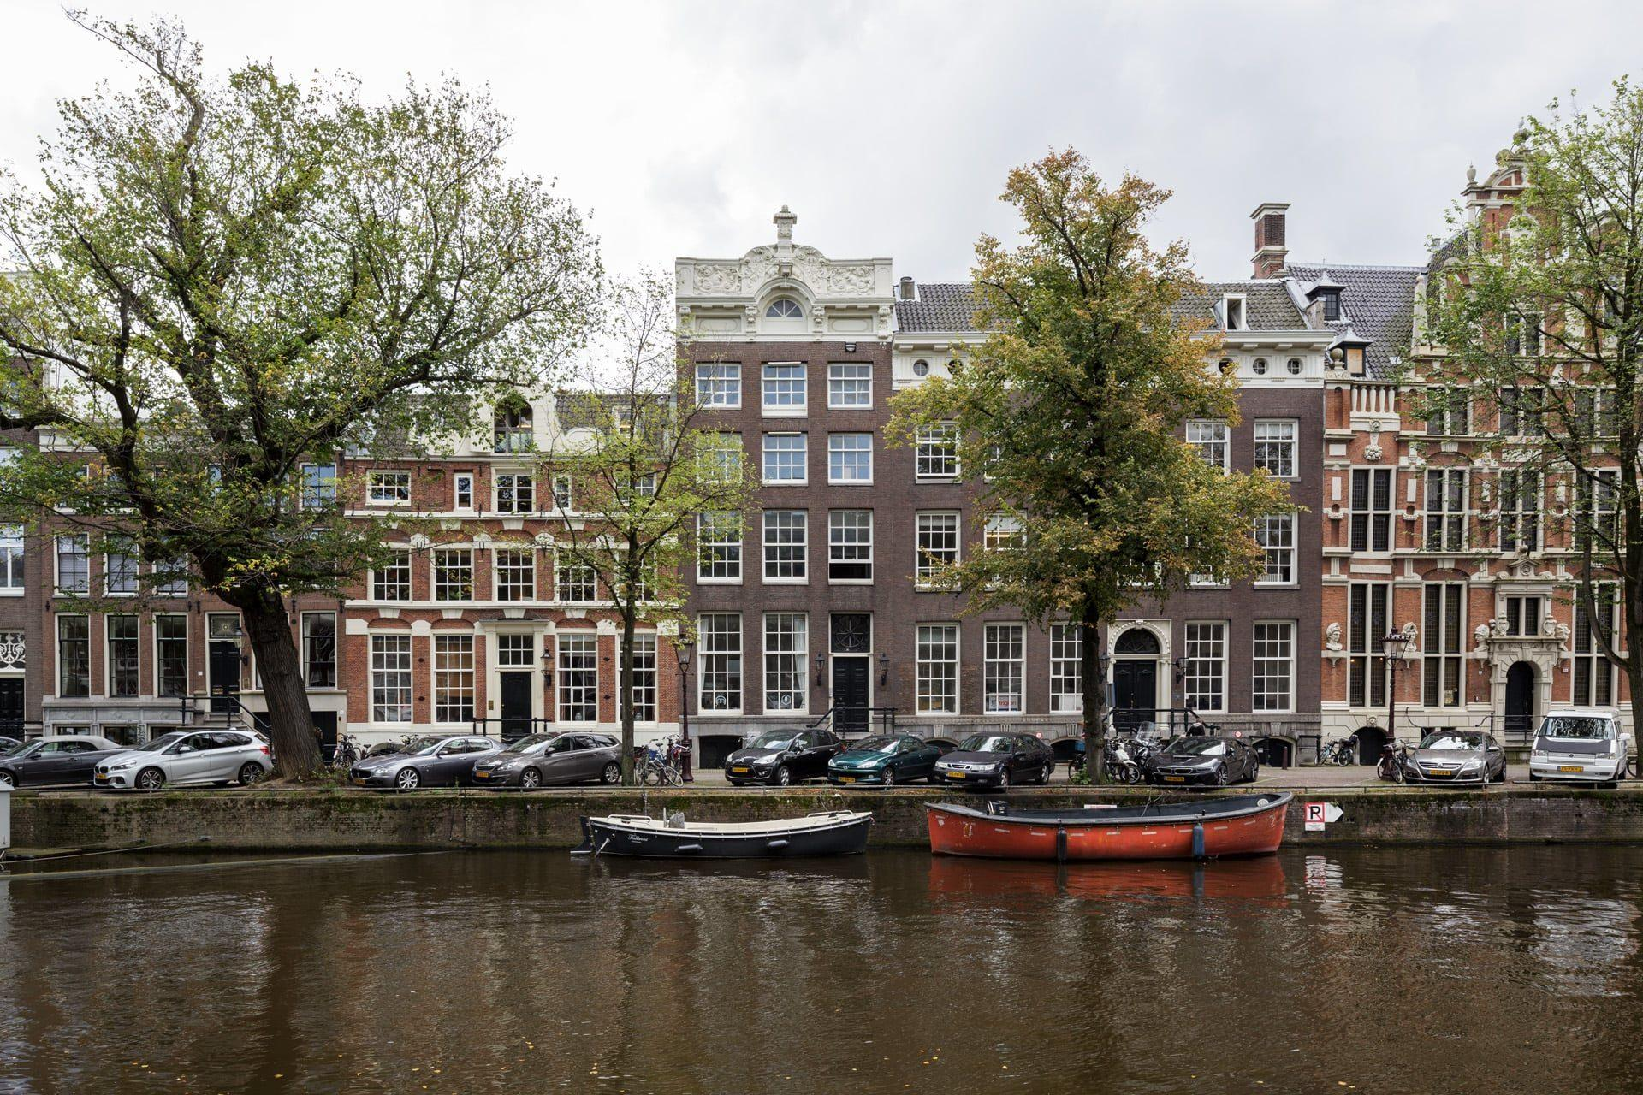

Slide 13
Thank you!

